Slide 1
Case Study
Brick Folio

Slide 2
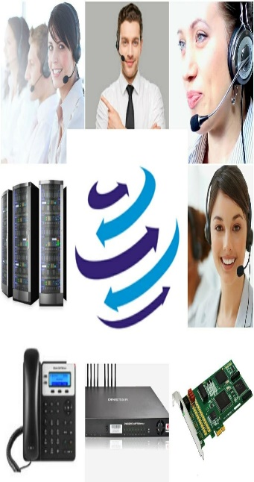
+91-856-00-00-600
www.dialerindia.com
avyuktaindia
CRM Based Dialer - IVR - Cloud Telephony
PRI Card - GSM Gateway - Servers - Headsets
(FXS/FXO/IP Phone// Press 1/ IP PBX)
Auto / Predictive / Hosted – WFH - PC Less – Android - Cloud Dialer
DoT Approved A / A+ Grade VoIP with/out Dialer Combo
Web / Software Development/e-Com / Custom Asterisk Solutions
+1-408-791-3820
+91-856-00-00-600
sales@dialerindia.com

Slide 3
Case Study Brick folio
About Brick Folio
Brick Folio is a real estate broker agency which deals in Commercial Property, Residential Property, Property Management Services and Property Sale, leasing and property investment Services. It also helps in property investments. Its headquarter is in Pune. It has many branches in major city’s of India like Mumbai, Nagpur, Delhi, Chennai, Hyderabad, Bengaluru. They Primarily focus on commercial and residential real estate which includes investment, leasing and resale. Brick Folio also provide instant support, extensive strategy and thought planning for projects it acquires. Brick Folio have big network of developers and investors they are experts in property deals. Brick Folio also helps in legal documentation for property sell, purchase or any lease cases. Brick Folio also helps for loan process. Mr. Danish Iqbal is MD- Cofounder of Brick Folio. Brick Folio has big team to deal with.

Slide 4
Case Study Brick Folio
Key Challenges Areas of Brick Folio
1. Customer did not have any automated calling process. Agents had to call with their mobile phones and had
to save their call records for any future reference/ requirements .
2. If there was any call back scheduled for any buyer or seller then there was no reliable call-back option even
for follow-ups.
3. They were not managing any database for their prospects, buyers, sellers, investors etc . Agents were
missing follow-ups, the previous conversations, remarks etc were not managed properly .
4. Dependency of agent for any buyer because other agents don’t know what deal an agent has done with
buyer or seller.
5. They were looking for a centralised calling system with CRM where the head office can upload the leads
for different cities and the central office can have their logs & recordings for each lead.
6. Brick Folio team was also looking for a solution which can be integrated with their in-house company CRM,
where they can upload all the data, leads and agents can dial through that CRM, and each and every call
need to be recorded centrally, also they need reports, records on a minimal clicks.

Slide 5
Case Study Brick Folio
Solutions we implemented at Brick Folio
1. We have implemented a centralized server at head office of Brick Folio with GSM gateway for outbound
calls.
2. Leads are uploaded by head office and the agents call with automated system according to their region or
city’s.
3. We integrated Brick Folio CRM with Avyukta Dialer, as per customer requirement we sync the data on real
time between these two applications over APIs.
4. Now Brick Folio have a big database of buyers, sellers, investors and property dealers, they can fetch their
records on minimal clicks and they can extract any recording of any agent or client on few clicks as well.
5. Now its very easy to make conference call for any agent for negotiation of property or any legal advice also,
due to every call recording it is difficult for anyone to alter any deal or any discussion
6. With our solution Brick Folio is now having centralized call recordings with all logs and history to evaluate /
track any kind of deal registered at Brick Folio just on few clicks.
7. Automated mail scheduled for all call logs to respective persons after duty hrs.

Slide 6
Case Study Brick Folio
Impact of our Solution in Brick Folio
After Implementation of all above mentioned solutions from Avyukta drastic changes came in overall experiences to both calling persons and tele callers. Key impacts are listed below:
1. Agent has assigned leads in their panel to contact, he/she need not to run here and there for any lead.
2. Automated Scripts with basic keyword which are used in their profession helped agents to impress client
while calling.
3. Follow-ups and call recording are arranged in proper manner and can be extracted on minimal clicks.
4. Overall manual work before the call is just eliminated by 85-90% with complete access of previous history
in few clicks only even the last call were completed by any other tele caller.
5. All concern authorities of Brick Folio have access to all logs, history, recordings on a single platform with
few clicks only which minimizes the manual efforts for them to get all things in shortest possible time.

Slide 7
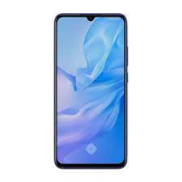
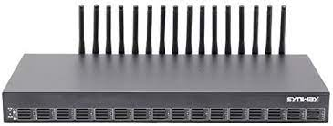
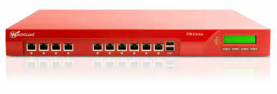
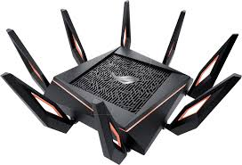
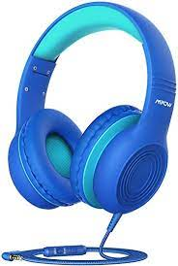
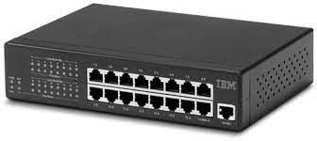
Case Study Brick Folio
Existing Architecture with GSM Gateway
Internet
Remote Agents
GSM Gateway
Firewall
Agent Floor
Wifi
Router
Avyukta
Dialer
Server
Admin / Quality / Supervisor / TL PC’s
Sales Force
Usb Headphone
Dialer Mobile
IP Phone
Soft Phone
Agent PC
25+ Reports
Voice Logs
Switch
Complete Recordings logs
Campaign Manager

Slide 8
Case Study Brick Folio
Brick Folio Call Flow
Internet
Remote Agents
Login – Public IP
http://103.68.9.166/
Admin / Quality / Supervisor / TL PC’s
GSM Gateway
Firewall
Wifi
Router
Agent Floor Local IP
Avyukta
Dialer
Server
Switch

Slide 9
E com / Mobile Apps / Website
Restaurant / Hotels / Customer Care
Recruitment / MIS / Placements / Admissions
Astrology / Universities / Colleges
Survey / Appointment Setting / Lead generation
Taxi Services / BPO / Collections
Insurance / Shares / Loan / DSA’s
Political Elections / Campaigns
24 X 7 X 365 “Decade” of 1900+ Satisfied BPO’s
avyuktaindia
Predictive / Auto Dialer: Current Calls/ Output X 400%
Hosted / Premised / BPO / DoT VoIP / PRI / GSM Gateway
Smart IVR / Cloud Telephony / Omni Channel / CRM / API
OBD / Press 1/ Voice SMS / Masking / OTP / 1800
Survey / Appointment Setting / Lead Generation
Domestic International Call Center / BPO Setup
The Competition Assassinators
275+ Live Ref. Centres
11 Yrs. X Asterisks Dev.
9 Countries,91+ Cities
Live Demo / PoC
Lower than the Lowest Professional Bidder
All possible Techno-commercial models
No Blame Game : Your CTI-CRM-VoIP “SPOC”
100% Gov. Compliance
72 HR Refund Policy
10% Ref. discount/s
24X6 Support NoC
“The” single Answer to your
A to Z
Tel- ”e” - calling requirements
+1-408-791-3820
+91-856-00-00-600
sales@dialerindia.com
Avyukta Intellicall www.dialerindia.com

Slide 10
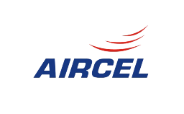
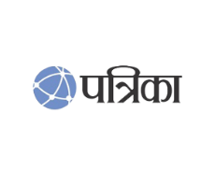
Trust over 11+ years
Some* Major Clients

Slide 11
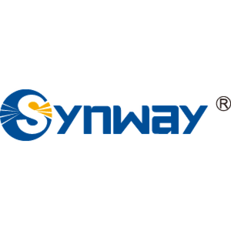
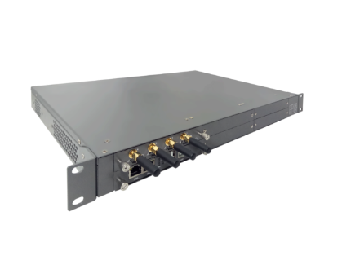
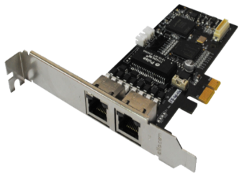
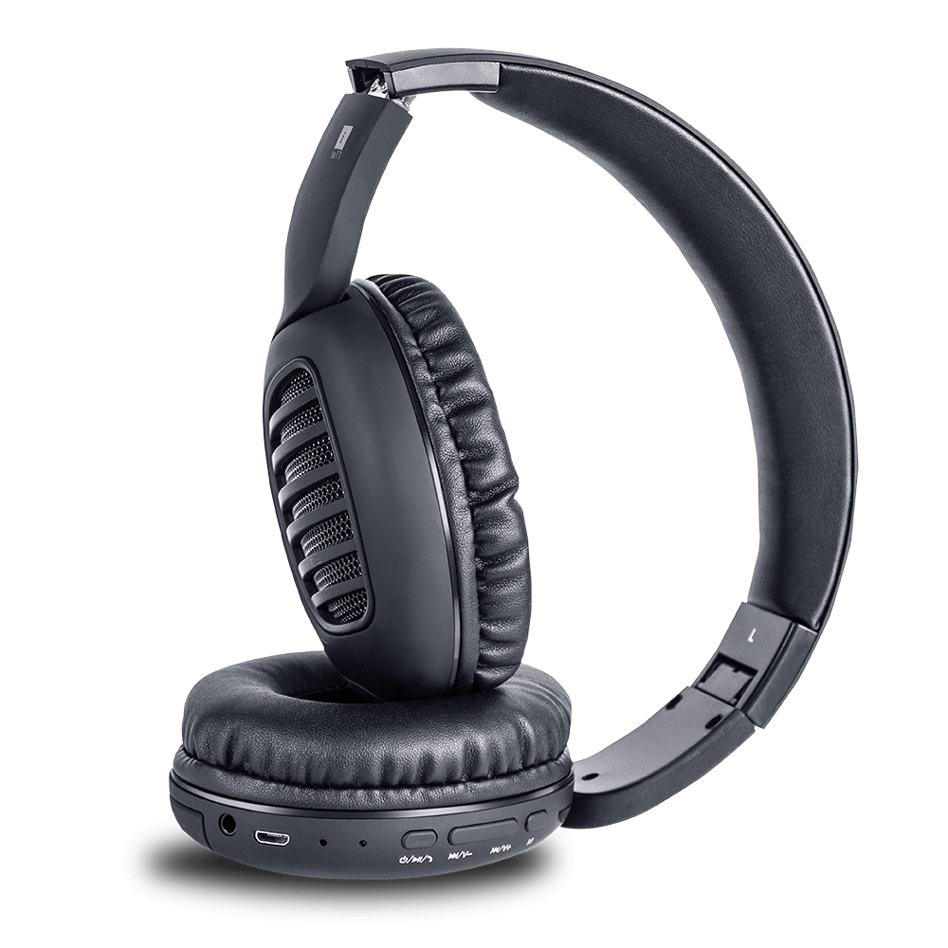
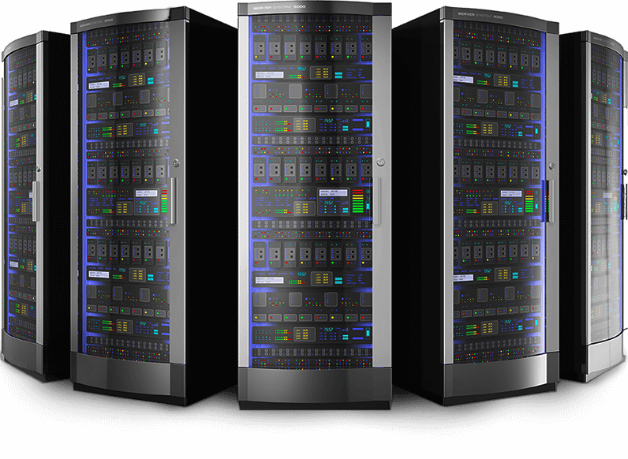
CTI Hardware Partners

Slide 12
Useful links
Domestic Architectures
International Architectures
Demo Video
Video Tutorials
Sample Voice Overs, Jingles and Melodies
DoT License / OSP Registration
PRI card / GSM Gateway / IP Phones / Headphone Buy Online
Vendor Comparison
Avyukta CRM Demo Video
Avyukta Sales CRM Demo Video
Avyukta Task CRM Demo Video
Avyukta Today CRM Demo Video
Request a Demo
Avyukta Client CRM Login
Support SLA
Avyukta on Youtube
Avyukta on Linkedin

Slide 13
Thank You For Your Valuable Time

